Slide 1
PET
DOCTOR
APP
Third Phase Report
Pet Doctor APP
Pet Doctor APP
宠物医生app第三阶段报告
Group members：杜卓航, 李苛垚, 黄熙晋, 鲍忠正

Slide 2
PET
DOCTOR
APP
01
Difficulty and effort of app development
应用程序开发的难度和工作量
02
App testing
CONTENTS
应用测试
Pet Doctor APP
03
User experience and improvement effects
目录
用户体验和改进效果
04
Team division of labor and cooperation effectiveness
团队分工与合作效能

Slide 3
PET
DOCTOR
APP
PART 1
Difficulty and effort of app development
Pet Doctor APP
PART ONE

Slide 4

Difficulty and effort of app development
1.1
应用程序开发的难度和工作量
Video introduction of Pet Doctor app

Slide 5
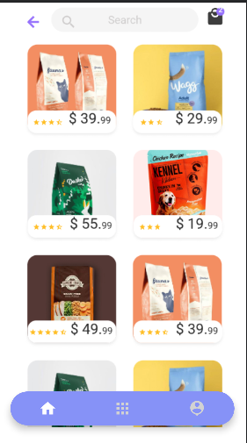
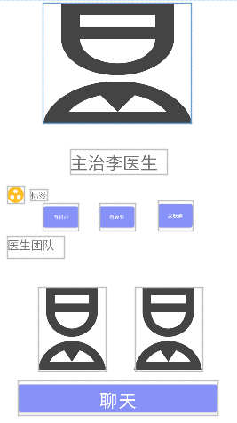
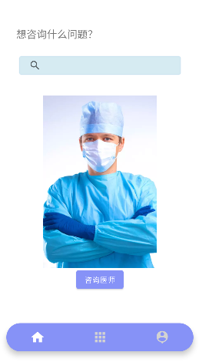
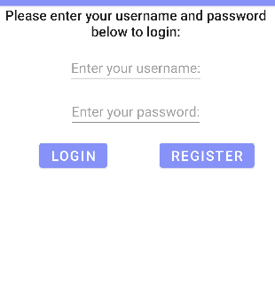
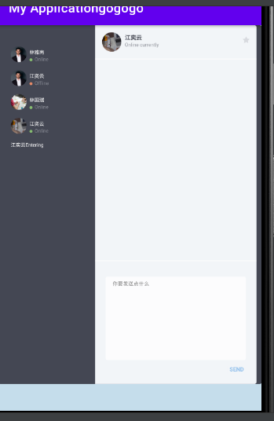
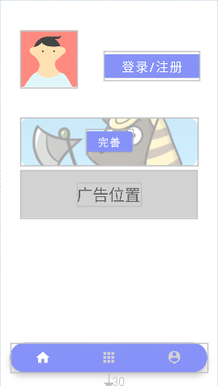
Difficulty and effort of app development
1.2
应用程序开发的难度和工作量
UI design
Chat interface layout
Theme colors

Slide 6
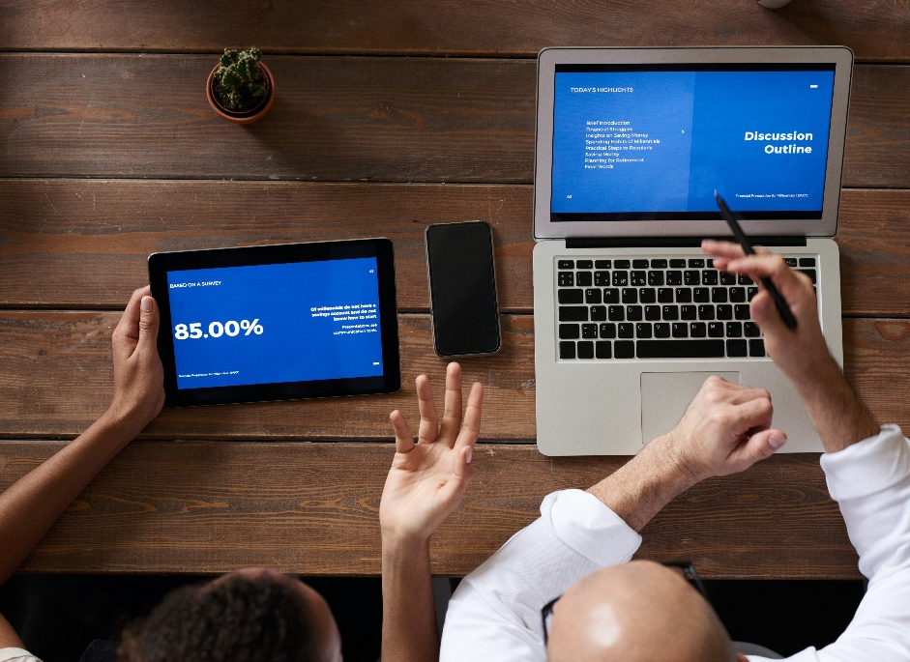
Difficulty and effort of app development
1.3
应用程序开发的难度和工作量
Main page
How to design a homepage that appeals to users and provides easy navigation?
Solution:
Identify the core functions and features of the home page, such as appointments, medical record management, etc., and place them in a prominent location.
Using a simple, intuitive design style, users can quickly understand and use each functional entry.
Use appropriate colors and ICONS to improve the visibility and ease of use of the interface.
Through the optimization of layout and components, ensure the loading speed and response performance of the main page.

Slide 7
Difficulty and effort of app development
1.4
应用程序开发的难度和工作量
Navigation page
How to handle navigation and interaction between different pages?
Solution:
Use the navigation components and fragments provided by Android Studio to manage and control the conversion and data transfer between pages.
Design the appropriate navigation bar and bottom navigation bar to provide intuitive page navigation and switching.
Using the functions of navigation components, parameter transfer and data interaction between pages are realized, ensuring that users can experience each functional module seamlessly.

Slide 8
Difficulty and effort of app development
1.5
应用程序开发的难度和工作量
Back-end data interaction
How does the data interact with the backend to enable users to ask questions of their pet doctor?
Solution:
Kotlin language is used to write network request code and communicate with server-side apis over HTTP protocol.
Use appropriate network request libraries in Android Studio, such as Retrofit, to simplify the operation and management of network requests.
Handles server responses and errors to ensure that user consultation requests are sent and received correctly.
Through the appropriate data structure and format, the user's consultation questions are passed to the pet doctor, and the doctor's response is displayed to the user in a timely manner.

Slide 9
PET
DOCTOR
APP
PART 2
App testing
Pet Doctor APP
PART TWO

Slide 10
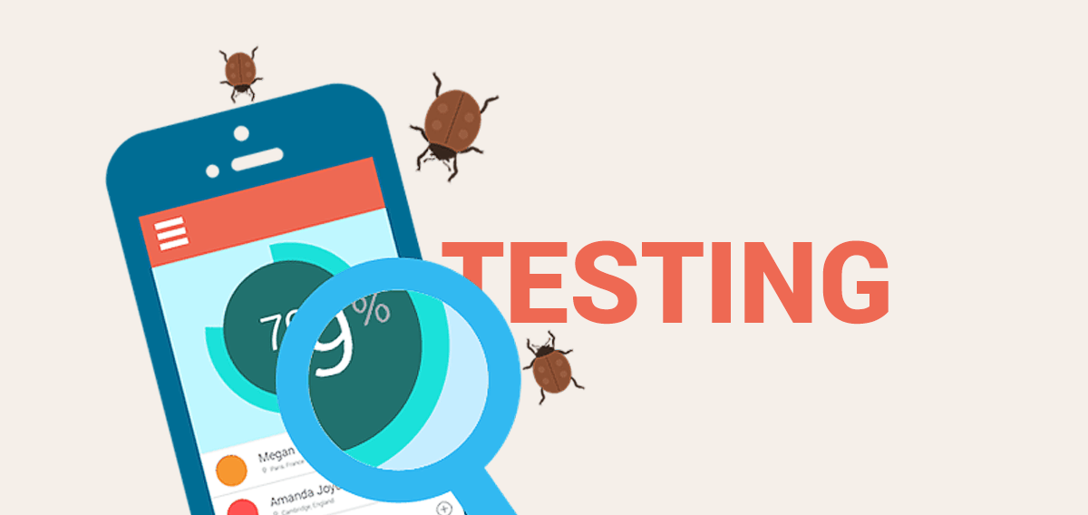
App testing
2.1
应用测试
Test objective
Ensure the normal operation of the Pet Doctor App.
Ensure user interface design is consistent with user habits and ease of use.
Ensure App compatibility across devices and Android versions.
Ensure App performance meets user expectations.

Slide 11
App testing
2.2
应用测试
Functional test
UI Test
Test the correctness and usability of each functional module.
Test whether the user interface design and interaction meet user expectations.
Test method
Compatibility test
Performance test
Test on different devices and Android versions to ensure App compatibility.
Test the App's loading speed, response performance, and resource usage.

Slide 12
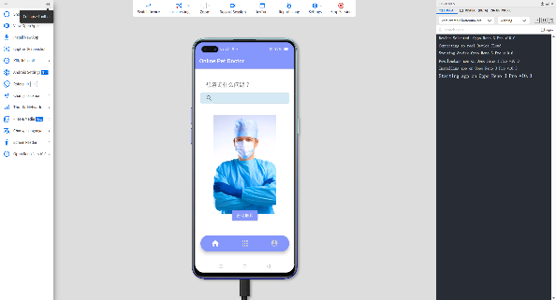

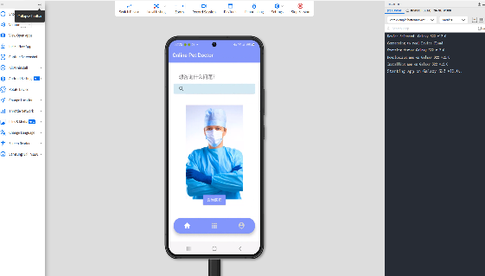
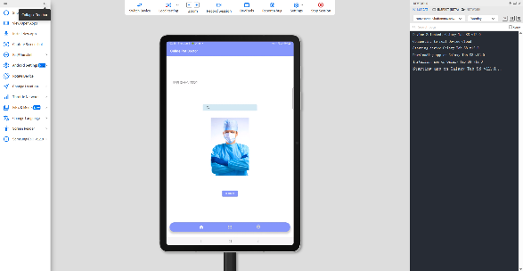
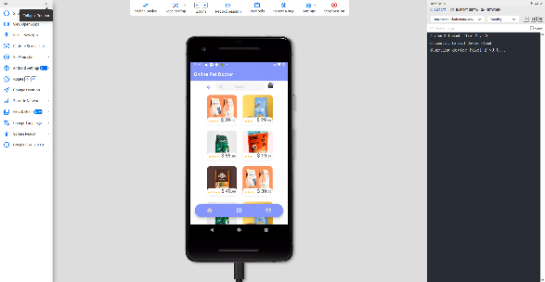
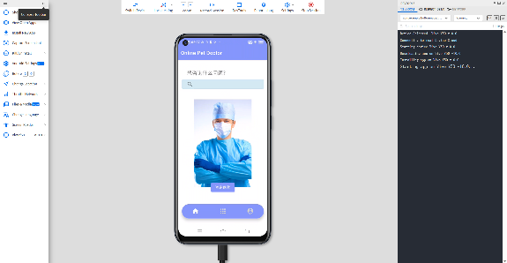
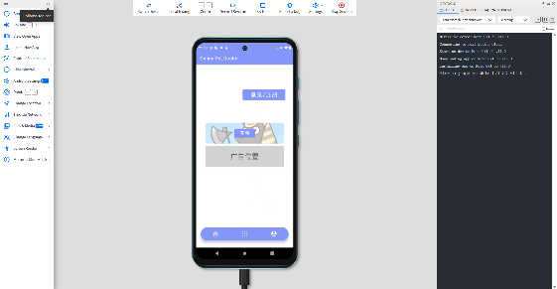
Test result
2.3
Tested phone:
vivo, Huawei, Samsung, pixel, moto, oppo

Slide 13
App testing
Test problems & solutions
2.4
应用测试
Solution 1
Problem 1: On some devices, the chat interface is displayed abnormally.
Problem 2: In some cases, the login authentication response time is long.
Problem 3: Apps load slowly on low-end devices.
Adapt and adjust the chat interface to ensure normal display on various devices.
Solution 2
Optimize login authentication logic, reduce response times, and optimize server-side performance.
Solution 3
Optimize the code to reduce unnecessary resource usage and improve loading efficiency.

Slide 14
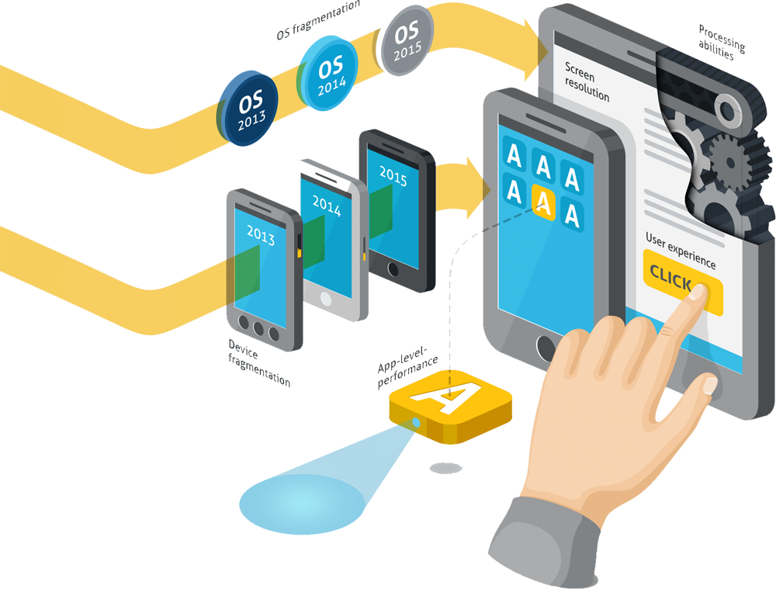
App testing
2.5
应用测试
Test summary
During the testing period, we focus on functional testing, user interface testing, compatibility and performance testing to ensure the stability, reliability and user experience of the App. Through systematic test methods and the execution of test cases, we have verified various functions of the App and solved some potential problems and improvement points. The test results show that the Pet Doctor App performs well in all aspects and has met the expected quality standards.

Slide 15
PET
DOCTOR
APP
PART 3
User experience &
improvement effects
Pet Doctor APP
PART THREE

Slide 16
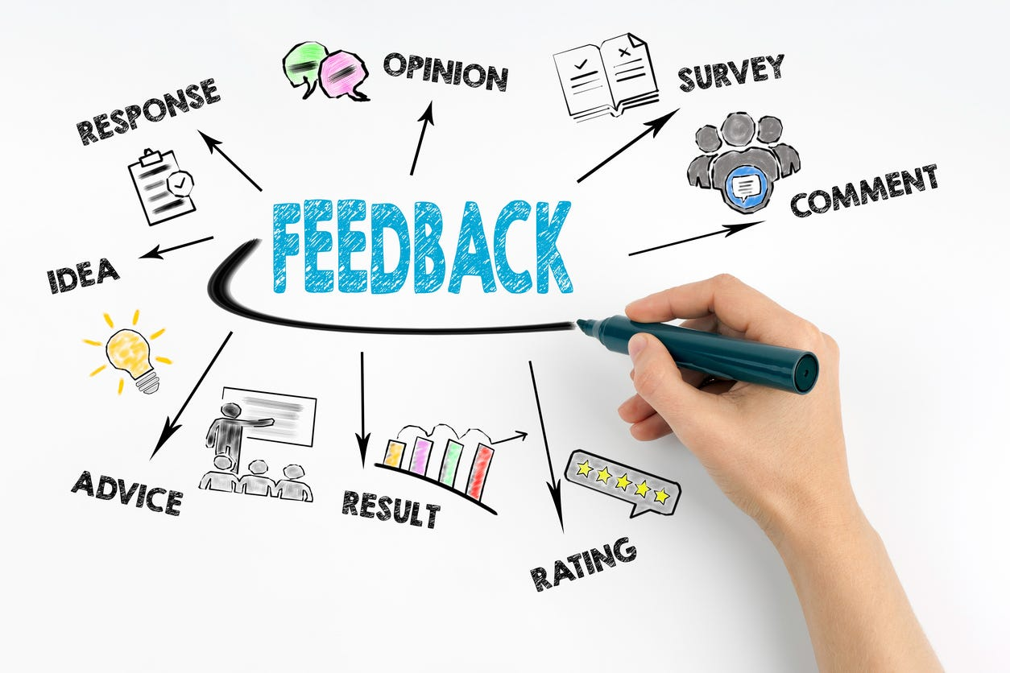
User experience & improvement effects
3.1
用户体验及改善效果
User feedback
Chat interface is beautifully designed and easy to use, making consulting a pet doctor simple and enjoyable.
Users appreciate the features of the personal page, especially pet health profile management, which can help them better manage their pet's health information.
Users say the design of the login interface is simple and intuitive, allowing them to easily authenticate and log in.

Slide 17
User experience & improvement effects
3.1
用户体验及改善效果
User feedback
Lack of background image and color
The initial button and bottom navigation color is too dark, which will make users feel a lit bit anxious.
The doctor page lack of time reservation function, thus users may fail to make reservation with the doctors.
Not enough functions for users to use.

Slide 18
User experience & improvement effects
3.2
用户体验及改善效果
Chat interface
Add message retraction and deletion capabilities to give users more control over their messages.
Improvement
User Profiles
Based on user feedback and comments, we plan to take the following actions to improve the functionality and interface:
Add more pet health file management functions, such as vaccine reminders and medication reminders, to help users take better care of pet health.
login interface
Introduce more third-party login options, such as Google and wechat login, to provide more choice and convenience.

Slide 19
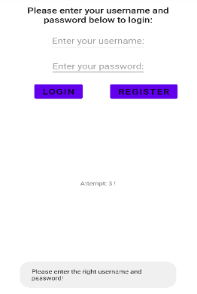
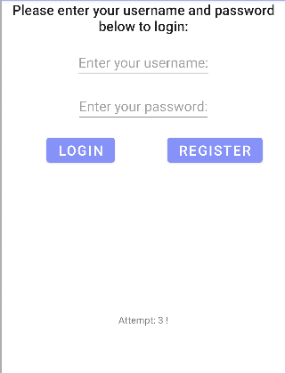
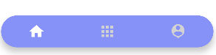

User experience & improvement effects
3.2
用户体验及改善效果
Improvement
We also improve our Ui interface to make it more suitable

Slide 20
PET
DOCTOR
APP
PART 4
Team division of labor & cooperation effectiveness
Pet Doctor APP
PART FOUR

Slide 21
Description of the Business
4.1
业务描述
杜卓航
黄熙晋
1. App：主页、登陆注册、底部导航条
2. App测试
3. PPT 补充
4.后期报告
1. APP: 解决聊天界面难题，以及医生界面的代码与布局
2. APP整体构思、功能实现手段
3.后期报告
How we work
鲍忠正
李苛垚
1. APP：导航页面
2. PPT 总体制作
3. 商业计划书
4. 后期报告
1. APP: 完善个人页面、宠物页面
2. 商业计划书
3. 后期报告
4. 用户测试

Slide 22
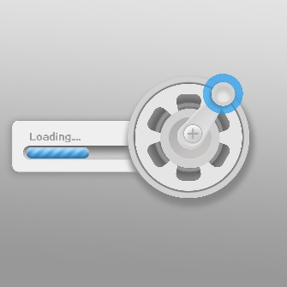



Market Analysis - User Persona
4.2
市场分析- 用户画像
Speed
Participation
Precision
Quality
01
02
03
04

Slide 23
PET
DOCTOR
APP
感谢观看
THANK YOU
Pet Doctor APP
Group members：杜卓航, 李苛垚, 黄熙晋, 鲍忠正

